Slide 1
Pearson Edexcel GCSE (9-1) Computer Science 2020 Guide to Supporting Documents and Delivery Materials (duration 15’30”)
A1356 ©Valery Brozhinsky/Shutterstock
March 2021

Slide 2
Resources
3 - Specification
5 - Programming Language Subset (PLS)
6 - Getting Started Guide
8 - Good programming practice Guide
10 - What’s changed and why
12 - Progression Guide
14 - Mapping Documents
16 - SAMs and Specimen papers
17 - Schemes of Work
19 - Video Resources
20 - Exemplar exam material
21 - Subject Guide
Notes:
This guide is intended to give quick access to key course documents and resources, to enable you to make decisions on which documents are relevant to your needs and most applicable to your educational setting. Guidance is given on the target audience for each resource, when each resource should be employed, which other resources may be of relevance and a summary of the key points of each resource. The resources can be selected individually or the entire collection studied in sequence by following this guide.

Slide 3
Specification
Summary – the full specification of the Computer Science GCSE
Audience – HODs, experienced teachers and NQTs
Usage - when planning delivery of a new Computer Science course
Purpose – formal description of the course, links to AO’s and details on how to deliver the GCSE
The Specification can be found here
Notes:
Specification
Summary – A 32 page detailed specification of the course with required content, assessment tasks and general administration requirements.
Audience – HODs and experienced teachers who require more information on the course content and structure when planning delivery. NQTs may want to refer to the specification in order to map GCSE requirements against Pearson’s implementation of the course.
When is it useful – When planning the delivery of a new course, the specification gives you clear guidance on what must be covered and how the students will be assessed.
Purpose – The specification is the formal description of the course, laying out what should be delivered, how its should be assessed, support and administrative details, alongside links to related documents and resources necessary to deliver the GCSE successfully.

Slide 4
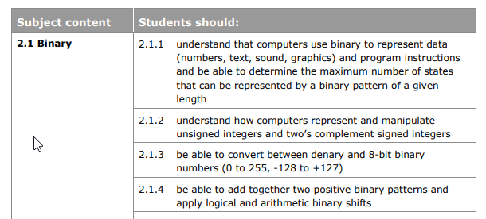
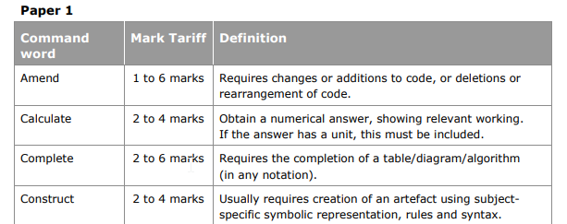
Related resources:
Getting started guide
Schemes of Work
Notes:
The Specification gives detailed information on the content and delivery of the GCSE Computer Science course.
[Screenshot 1]
Each of the 6 topics included in the GCSE are specified in detail, showing what content needs to be covered. Administrative requirements are then discussed so that teachers are aware of the how assessment is carried out and how this ties into Ofqual objectives.
[Screenshot 2]
Additionally, information is provided on key areas such as command word taxonomy, flowchart symbols and qualification codes. Links are provided to other key documents and resources which provide supplementary information related to the specification.
[Item 3]
Related resources – Other resources that are related to this resource include The Getting started guide and Schemes of Work.

Slide 5
Programming Language Subset (PLS)
Summary – the PLS specifies which parts of Python 3 are required in order that Paper 2 assessments can be covered in full
Audience – HODs and experienced teachers
Usage – when planning the coverage and detail of programming techniques that need to be communicated to students
Purpose – to clearly show the scope of Python skills that are required, in order to address all possible questions in Paper 2
The PLS can be found here
Related resources:
SAMs and Specimen papers
Good programming practice Guide
Exemplar exam material
Notes:
Porgramming Language Subset
Summary – The PLS details in 12 pages all of the Python 3 commands and structures that are required for students to access all of the questions that may be encountered in Paper 2 of the course.
Audience – Teachers experienced with Python or other programming languages will find this document useful.
When is it useful – Once Pearson’s GCSE has been selected, it is essential that the PLS is studied carefully to ensure that all areas are taught to students, enabling them to maximise their success in Paper 2 – the on-screen exam. The PLS is also provided to students during the exam.
Purpose – The PLS’s purpose is to comprehensively detail all of the Python commands, techniques, structures etc. that are required to be taught in order for students to be able to answer all possible questions encountered in Paper 2.

Slide 6
Getting Started Guide
Summary - details the changes that have been made to the Computer Science GCSE to assess programming skills by exam only. It clarifies the scope of what should be taught with reference to the specification
Audience – HODs, NQTs and experienced teachers
Usage - when planning delivery of a new Computer Science course
Purpose – to clarify what is covered by the new content, exemplify and scope the specification in detail, and explain how the new assessment operates
The Getting Started Guide can be found here
Notes:
Getting Started Guide
Summary – An expanded 43 page version of the “What’s changed and why” document that details the changes that have been made to the Computer Science GCSE following the request from Ofqual that all exam boards assess programming skills by exam only. Clarification is given on what exactly needs to be taught with cross-references to the Specification document. In essence, it clarifies the scope of what should be taught with reference to the specification.
Audience – NQT and experienced Teachers and HODs who taught the previous version of GCSE Computer Science which required the completion of an NEA or who are starting on GCSE Computer Science for the first time.
When is it useful – This document is most useful when you are planning delivery of a new Computer Science course, especially if transitioning from an NEA-based GCSE.
Purpose – This document’s purpose is to lay out in detail all of the content that needs to covered and how the content will be assessed in the two papers. It is also useful when mapping existing courses and resources to the new specification, as it exemplifies and scopes the specification in detail.

Slide 7
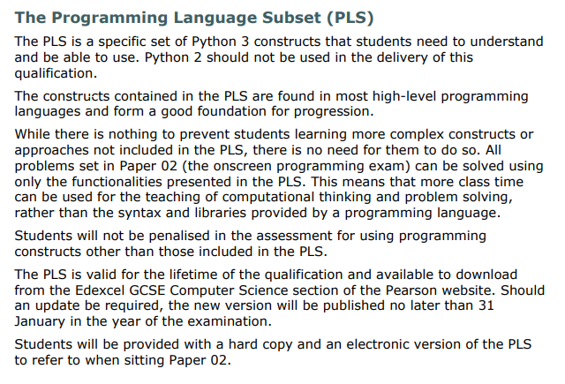
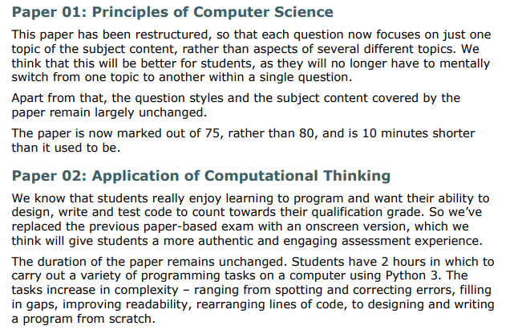
1. How content and assessment has changed from previous GCSE Computer Science
2. What content is included in the GCSE and how this is assessed
Related resources:
What’s changed and why
The full course specification Good Programming practice guide
Progression guide
Practical Programming Activities and Solutions
Mapping Documents
Subject Guide
Notes:
This document focuses on two main areas.
[Screenshot 1]
Firstly, how content and assessment has changed from previous GCSE Computer Science which included the NEA. Changes in content to the 6 topic areas are summarised as well as the Programming Language Subset (PLS) that specifies what Python 3 constructs are required to be studied by students.
[Screenshot 2]
And secondly, detailed guidance and justification about what content is included in the GCSE and how this is assessed. The previous assessment activities are then compared with the new assessment tasks, highlighting the benefits of the new assessment methods.
[Item 3]
Related resources – Other resources that are related to this resource include What’s changed and why, The full course specification, Good Programming practice guide, Progression guide, Mapping Documents and Practical Programming Activities and Solutions

Slide 8
Good Programming Practice Guide
Summary – Details the Python functionalities that will be assessed by the course, further exemplifying the PLS
Audience – HODs and teachers of the new GCSE. NQTs.
Usage – planning Python programming lesson content
Purpose – expands on the PLS to show how best to implement the techniques and commands specified in the PLS
The Good Programming Practice Guide can be found here
Notes:
Good Programming Practice Guide
Summary – This guide details the functionalities of Python 3 that are included in the Programming Language Subset (PLS) of the GCSE. It should be read in conjunction with the Programming Language Subset.
Audience – HODs or experienced teachers will find this useful when planning the Python features to include in the course delivery. NQTs may also find the guide useful.
When is it useful – When planning lesson content related to practical programming skills, the guide helps to focus on those areas needed for the GCSE. NQTs may find this useful when learning Python programming as it helps to narrow down the skills and capabilities required of teachers.
Purpose – In 24 pages, the GPPG exemplifies how to best use each of the commands, structures and techniques covered by the PLS. This allows teachers to deliver the content with confidence, enabling them to teach students good programming practice that will maximise their chances of success in paper 2 of the course.

Slide 9
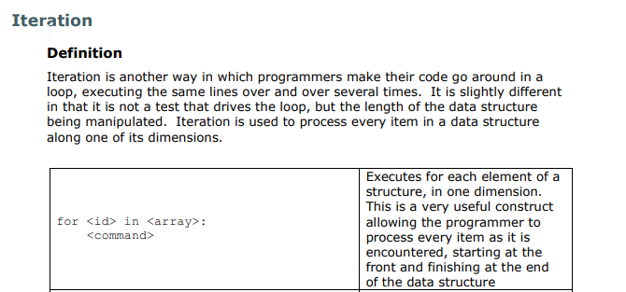
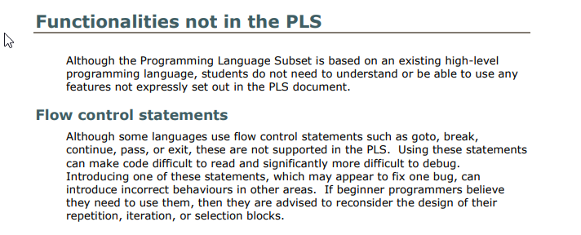
Related resources:
Practical Programming Activities and Solutions
Schemes of Work
Video Resources
Programming Language Subset (PLS)
Notes:
[Screenshot 1]
All of the functionality covered in the Programming Language Subset (PLS) is detailed with examples of usage. This gives clear guidance to teachers on what Python skills need to be taught. The functionalities covered are those that transfer easily to all programming languages, helping with future progression from the GCSE course.
[Screenshot 2]
Additionally, a number of functionalities not required are covered. These cover areas such as flow control handling and exception handling.
[Item 3]
Related resources – Other resources that are related to this resource include Practical Programming Activities , Video Resources and Schemes of Work.

Slide 10
GCSE Computer Science 2020 – What’s changed and why
Summary – a brief outline of changes made to the Computer Science GCSE in line with Ofqual’s requirements
Audience – HODs and experienced teachers who have previously delivered Pearson Computer Science
Usage - when planning delivery of a new Computer Science course
The Progression Guide can be found here
Notes:
What’s Changed and Why
Summary – A brief, 4 page document that outlines the changes that have been made to the Computer Science GCSE following the request from Ofqual that all exam boards assess programming skills by exam only.
Audience – Teachers or HODs who taught the previous version of GCSE Computer Science which required the completion of an NEA.
When is it useful – This document is most useful when you are planning delivery of a new Computer Science course, especially if transitioning from an NEA-based GCSE.

Slide 11
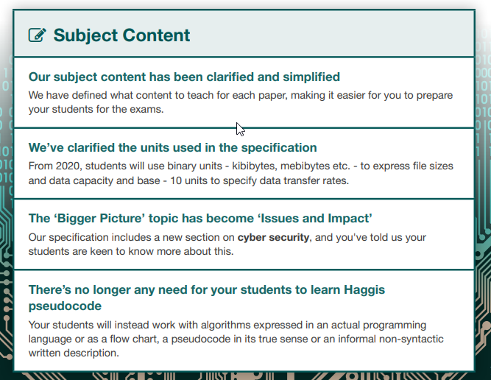
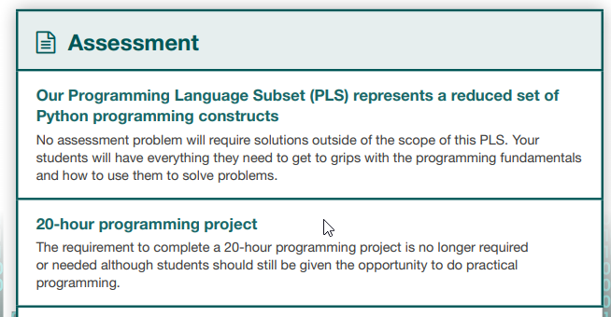
Related resources:
Getting started
The full course specification
Notes:
[Screenshot 1]
This document gives one page summaries of what has changed from the old specification. The revision of subject content is outlined along with support available in delivering the new content.
[Screenshot 2]
Further information is provided on how assessment is performed in the two papers, with particular focus on the new onscreen task which assesses students’ programming ability and replaces the previous NEA.
[Item 3]
Related resources – Other resources that are related to this resource include Getting Started and the full course specification.

Slide 12
Progression Guide
Summary – how the Pearson GCSE Computer Science course ties into progression to Level 3 qualifications
Audience – HODs within schools with 6th Form students. NQTs.
Usage - when advising students on 6th form options or when choosing level 3 qualification options
The Progression Guide can be found here
Notes:
Progression Guide
Summary – The guide details opportunities for student progression to level 3 qualifications including how well the GCSE leads into all the main exam board A’ Levels, BTECs and the T-level pathway. The guide has been constructed with the input of teachers experienced with typical progression routes when studying Computer Science.
Audience – HODs in schools with 6th form cohorts or those advising students on progression into Key Stage 5. NQTs may also find this document useful in understanding how different levels of qualification allow for progression through common content.
When is it useful – For HODs who are looking at how to use the GCSE as a progression to Level 3 qualifications or are advising students on options at Key Stage 5.

Slide 13
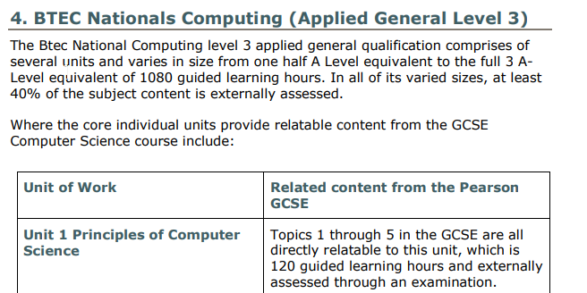
Page extracts from Progression Guide
Notes:
[Screenshot 1]
Content covered in the GCSE that is built upon in A levels from AQA and OCR is detailed, with particular focus on how the on-screen test and its related content gives students excellent preparation for similar practical activities at A’ level.
[Screenshot 2]
The links between Pearson’s BTEC and the GCSE are detailed with information on common content in each of the units of work for both the Computing and IT Nationals. The progression opportunities with the T-level in Digital Production, Design and Development are then discussed with focus on the overlap with the Python programming component.

Slide 14
Mapping Documents
Summary – Each document compares the new Pearson Computer Science GCSE with the respective exam board’s 2016 Computer Science GCSE specification
Audience – HODs who are planning on moving from a different exam board to Pearson’s new specification
Usage – When comparing a 2016 specification GCSE with the new 2020 specification, these documents help understand the overlap and difference in content and assessment.
The Mapping documents for each exam board can be found below
Pearson AQA OCR Edquas
Paul Long has also created a comparison of 3 boards’ approaches to GCSE
Notes:
Mapping Documents
Summary – The four mapping documents contain comprehensive information on how much overlap and difference there is between Pearson’s 2020 GCSE specification and other exam board’s 2016 GCSE specifications.
Audience – HODs and experienced teachers
When is it useful – For those teachers familiar with the 2016 GCSEs from Pearson or other exam boards, this document helps understand which existing teaching materials may be utilised in the delivery of the Pearson 2020 course and also where new materials may need to be developed.

Slide 15
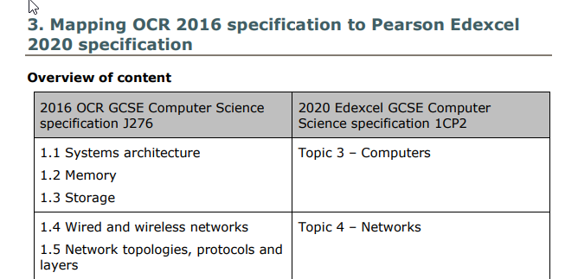
Related resources:
Specification
Schemes of Work
Notes:
[Screenshot 1]
The mapping documents begin with an overview of the content of the 2020 Pearson GCSE and how it aligns with the topics in the other respective 2016 GCSEs. There is also an outline of the assessment requirements in the 2020 GCSE, enabling teachers to compare current assessment practices with those required by Pearson.
[Screenshot 2]
Secondly, each topic in the new GCSE is compared in detail with the corresponding area in the 2016 GCSE. Not all topics will have direct equivalents because of the introduction of new content. For each topic, detail is given on what content is new and what content will no longer be required.
[Item 3]
Related resources – Other resources that are related to this resource include The full course specification and Schemes of Work.

Slide 16
Sample Assessment Materials (SAMs) and Specimen Papers
Summary – The Sample Assessment Materials and Specimen Papers give example papers for both components of the qualifications, accompanied by mark schemes used by examiners.
Audience – Teachers and HODs
Usage – When preparing students for both exam papers, the materials will provide example questions and answers.
The Sample Assessment Materials (SAMs) can be found here
The Specimen Papers can be found here
Related resources:
Video Resources
Exemplar Exam Materials
Programming Language Subset (PLS)
Notes:
SAMs and Specimen Papers
Summary – Both of these resources give example papers for the two components of the qualifications, accompanied by mark schemes used by examiners. The Sample Assessment Materials also include code files for example questions in paper 2 of the specification.
Audience – Teachers of the GCSE along with HODs will find these resources useful throughout the course.
When is it useful – Towards the end of Year 11 when students are being prepared for exams and mock exams, teachers will find it useful to refer to past papers and exemplar answers to both papers 1 and 2, making students aware of the nature of questions they can expect to encounter in their exams. These SAMS are silver padlocked and require a secure login for access, thus providing opportunities for secure assessment.
Related resources – Other resources that are related to this resource include Video Resources and Exemplar Exam Materials.

Slide 17
Schemes of Work
Summary – A detailed scheme of work containing lesson plans, activities (with related solutions) and links to additional resources
Audience – HODs and teachers
Usage – When planning the two year delivery of the new GCSE course, the Schemes of Work help to schedule lessons and assessments
The Schemes of Work can be found below
Interactive Scheme of Work
Editable Scheme of Work (Select Scheme of Work)
Notes:
Schemes of Work
Summary –The detailed schemes of work contain full lesson plans, practical activities to stimulate student interest and solutions to exam style questions and tasks. The activities are accompanied by comprehensive solutions. Other resources are referenced, both from Pearson and third parties.
Audience – HODs when planning the two year delivery of the course and also teachers who may want to look for relevant activities and lesson ideas
When is it useful – In the planning of a new course so that HODs can schedule activities with confidence, knowing that the specification will be covered in full.

Slide 18
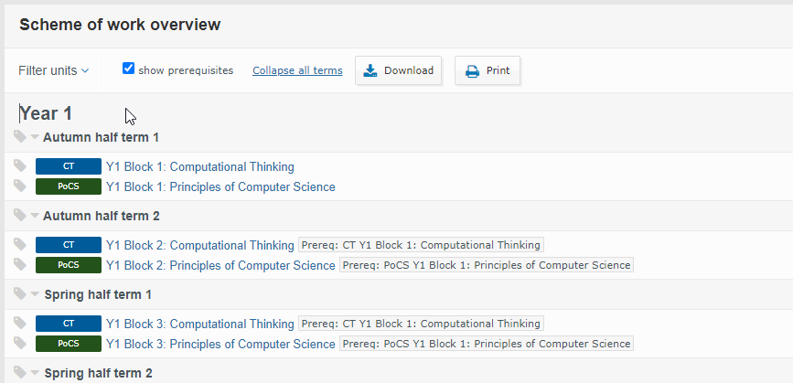
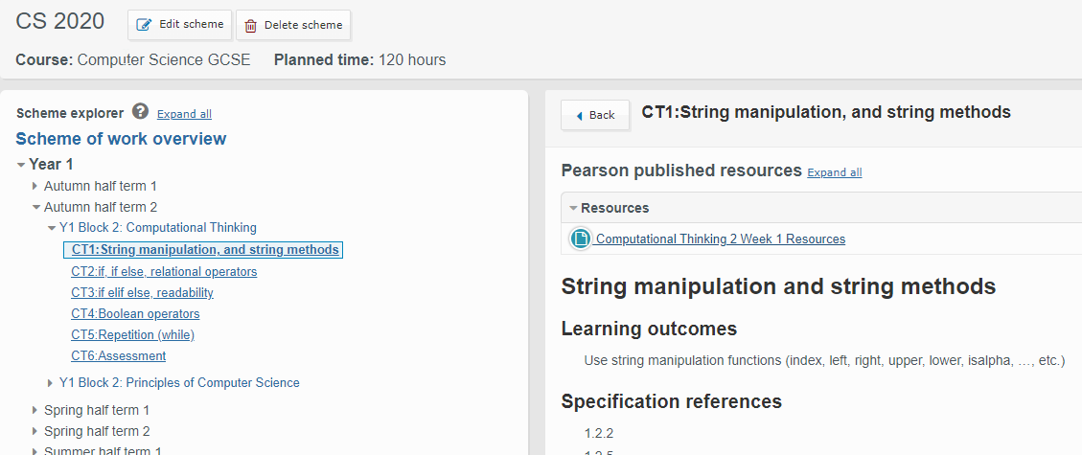
Related resources:
Specification
Notes:
[Screenshot 1]
The interactive Scheme of work includes a full breakdown of the two year course into half termly blocks with resources for Computational Thinking and for Principles of Computer Science.
[Screenshot 2]
The blocks are then divided into individual topics, accompanied by Learning Outcomes, references to the specification, lesson plans and assessment tasks. The scheme of work can be customised to suit an establishment’s particular requirements.
[Item 3]
Related resources – Other resources that are related to this resource include The full course specification.

Slide 19
Video Resources
Summary – Videos and commentary showing how to perform common programming tasks associated with paper 2
Audience – Teachers and NQTs
Usage – The video resources allow teachers to become familiar with typical tasks required for paper 2 and can also be used to assist students in their development of programming skills
The Video Resources can be found here
Related resources:
Sample Assessment Materials and Specimen Papers
Exemplar Exam Materials
Notes:
Video Resources
Summary – The 10 videos and accompanying commentary explain how to perform commonly required programming tasks and also explain how marks are awarded for example Paper 2 questions.
Audience – teachers and NQTs who are unfamiliar with programming skills and how to assess the paper 2 questions
When is it useful – In explaining to teachers and students how to perform programming tasks and how to answer different types of questions found in paper 2. These can be used to prepare teachers prior to delivery of content, or can be used to help students with exam preparation.
Related resources – Other resources that are related to this resource include Sample Assessment Materials and Specimen Papers and Exemplar Exam Materials.

Slide 20
Exemplar Exam Materials
Summary – A comprehensive set of annotated exam questions, exemplar code files and levelled answers for the on-screen assessment portion (paper 2) of the GCSE.
Audience – Teachers and HODs
Usage – To explain how the on-screen assessment tasks are assessed and where marks can be gained or lost.
The Exemplar Exam Materials can be found here (.zip file, not direct link)
Additional materials (Specimen paper 2 for sets 1-3) coming soon
Related resources:
Video Resources
Sample Assessment Materials and Specimen Papers
Programming Language Subset (PLS)
Notes:
Exemplar Exam Materials
Summary – The on-screen assessment task (paper 2 only) is broken down into exemplar questions, each accompanied by detailed Level Based Mark schemes for a variety of student answers, covering a wide range of marks. Exemplar student python files are included along with finished python solutions.
Audience – all teachers of the level 2 paper materials along with HODs will find the materials useful in preparing students for the on-screen exam.
When is it useful – When teachers wish to learn how particular types of Python tasks are assessed. The exemplar answers, levelled student responses and accompanying explanations will aid in the clear understanding of how to gain marks in paper 2. There will be additional material such as levelled specimen papers accompanied by a voice-over walk thought, coming shortly.
Related resources – Other resources that are related to this resource include Sample Assessment Materials and Specimen Papers and Video Resources.

Slide 21
Subject Guide
Summary – an overview of the entire 2020 specification GCSE with details of support and resources available to schools
Audience – HODs, NQTs and experienced teachers
Usage - when planning delivery of a new Computer Science course
The Subject Guide can be found here
Notes:
Subject Guide
Summary – This 16 page document gives a high level overview of the new GCSE course, the support available and details of the assessment methods used. The major strengths of the course are also detailed, enabling early comparisons to be made with alternative exam board courses.
Audience – All levels of teacher will benefit from this document, enabling them to understand the new course at a high level.
When is it useful – This document is most useful when you are planning delivery of a new Computer Science course, especially if transitioning from an NEA-based GCSE.

Slide 22
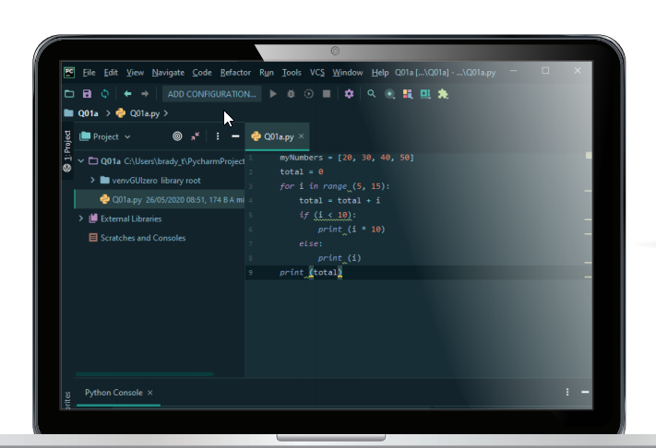
Related resources:
Getting started guide
What’s changed and why
Notes:
[Screenshot 1]
One of the major changes to the GCSE specification is the inclusion of an on-screen Paper 2 exam to assess students’ ability to program, replacing the less rigorous paper-based assessments previously used.
[Screenshot 2]
Pearson has invested large amounts of time and resources into developing excellent resources so that teachers can plan, deliver, and assess the course knowing that they will have materials and support available at all stages.

